Slide 1


Data Science and ArcGIS
Integrating R, Python, and Machine Learning Techniques
into the ArcGIS Platform
Presented by,
Parker Hornstein

Slide 2

Agenda:
Fundamental GIS Concepts
ArcGIS-R Bridge
ArcGIS Python API
Machine Learning and ArcGIS
Q&A

Slide 3

Fundamental GIS Concepts
What is geospatial data and how do I ingest it?
Feature classes
Vector data
Contains attributes stored as tabular data
All features have a common schema
Shape files
A collection of feature classes of the same feature type
The GeoDatabase
A collection of feature classes of one OR MORE feature types
Hosted feature service
A feature class hosted on a server
When hosted on Server for ArcGIS these will have a REST endpoint

Slide 4
Fundamental GIS Concepts
What is geospatial data and how do I ingest it?
Points
Lines
Polygons

Slide 5
R Bridge for ArcGIS
Configuring
Requirements:
ArcGIS Pro 1.1 or Higher
R 3.2.2 or Higher
R Studio or preferred R workstation
Reference documentation:
https://github.com/R-ArcGIS/r-bridge

Slide 6
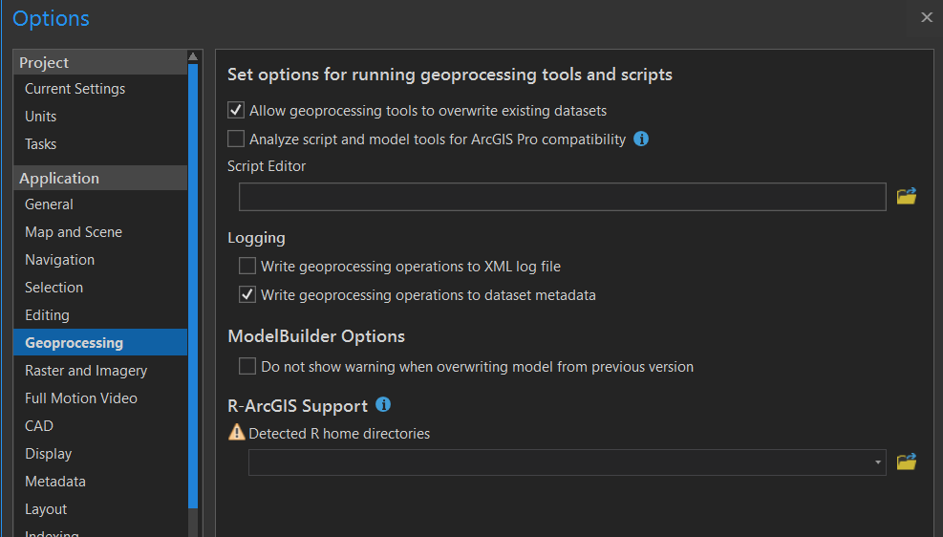
R Bridge for ArcGIS
Configuring
Steps for configuring:
Install ArcGIS Pro
Install R
In ArcGIS Pro:
Open options
GeoProcessing
Point to R Installation
Confirm installation, in R-Studio:
> library(arcgisbinding) //establishes link between ArcGIS Pro and R
> arc.check_product() //confirms valid installation and version of ArcGIS Pro

Slide 7
R Bridge for ArcGIS
Configuring
DEMO
Configuring R-Bridge

Slide 8
Python API
Intro and Best Practices
Esri recommends implementing Python with Anaconda
Current version required Python 3.6
Can be installed from Anaconda Package explorer
Is automatically installed with ArcGIS Pro
Can be used for scripting (automating processes) or data science
If being used for data science, use jupyter

Slide 9
Python API
Intro and Best Practices
ArcGIS Pro:
Anaconda is automatically installed with ArcGIS Pro
ArcPy is automatically installed
Creates environment “arcgispro-py3”
C:\Program Files\ArcGIS\Pro\bin\Python\envs
Best practice is to clone this environment, not work from root
Can still integrate with other packages, use conda install
Jupyter is automatically installed
Launched form command shell
Anaconda:
Install on package manager
Can be integrated into your preexisting environments
Works with any applications installed via Anaconda

Slide 10
Python API
Configuring with Anaconda
DEMO
Configuring Python with Anaconda

Slide 11
Python API
Configuring with ArcGIS Pro
DEMO
Configuring Python with ArcGIS Pro

Slide 12
Python API
Recommended Modules
GIS
Interacting with data from a Portal
Includes classes for authentication
Also consider using LastPass
Features
interact with feature classes
Download, convert type (i.e. to Pandas DF)
Call specific fields and attributes
GeoAnalytics
Provides types and functions for working with big data
Used to interact with Big Data Stores and GeoAnalytic servers
Geometry
Used to ingest and convert geometry types
For example: using 4 points types to create a polygon
Mapping
Used for visualizing data in both 2D and 3D
Contains components for creating webmaps and webscenes
MapView
Used similarly to Mapping, but for Jupyter
Visualize maps directly in Jupyter

Slide 13
Python API
ArcGIS Pro and Python
ArcGIS Pro can be used for create training data
Use random points tool
Options for filling data:
Use field calculator and random function
Use proximity functions to select and fill selected features
Create training lines and convert lines to points (to sim tracks)
ArcGIS Pro has a Python console for scripting commands
Jupyter notebook can be launched from included power shell
Use command “jupyter notebook”
Runs on localhost

Slide 14
Python API
ArcGIS Pro and Python
DEMO
Creating Training Data with ArcGIS Pro

Slide 15
ArcGIS A Platform for Developers
Major Advancements
JavaScript
Runtime
Python Web Scripting
Pro Customizations
Python
API
Runtime SDKs
JavaScript
API
HTML5
Python
C#
.NET
Open Development and Scripting Tools
Java
Kotlin
Xamarin
Qt
C++
JavaScript
REST
Swift
For Devices, Web, and Desktop
Objective-C
ArcGIS Developer Program
Supporting Enterprise Developers . . .
and the Creative “Maker” Community
Notes:
Eric

Slide 16
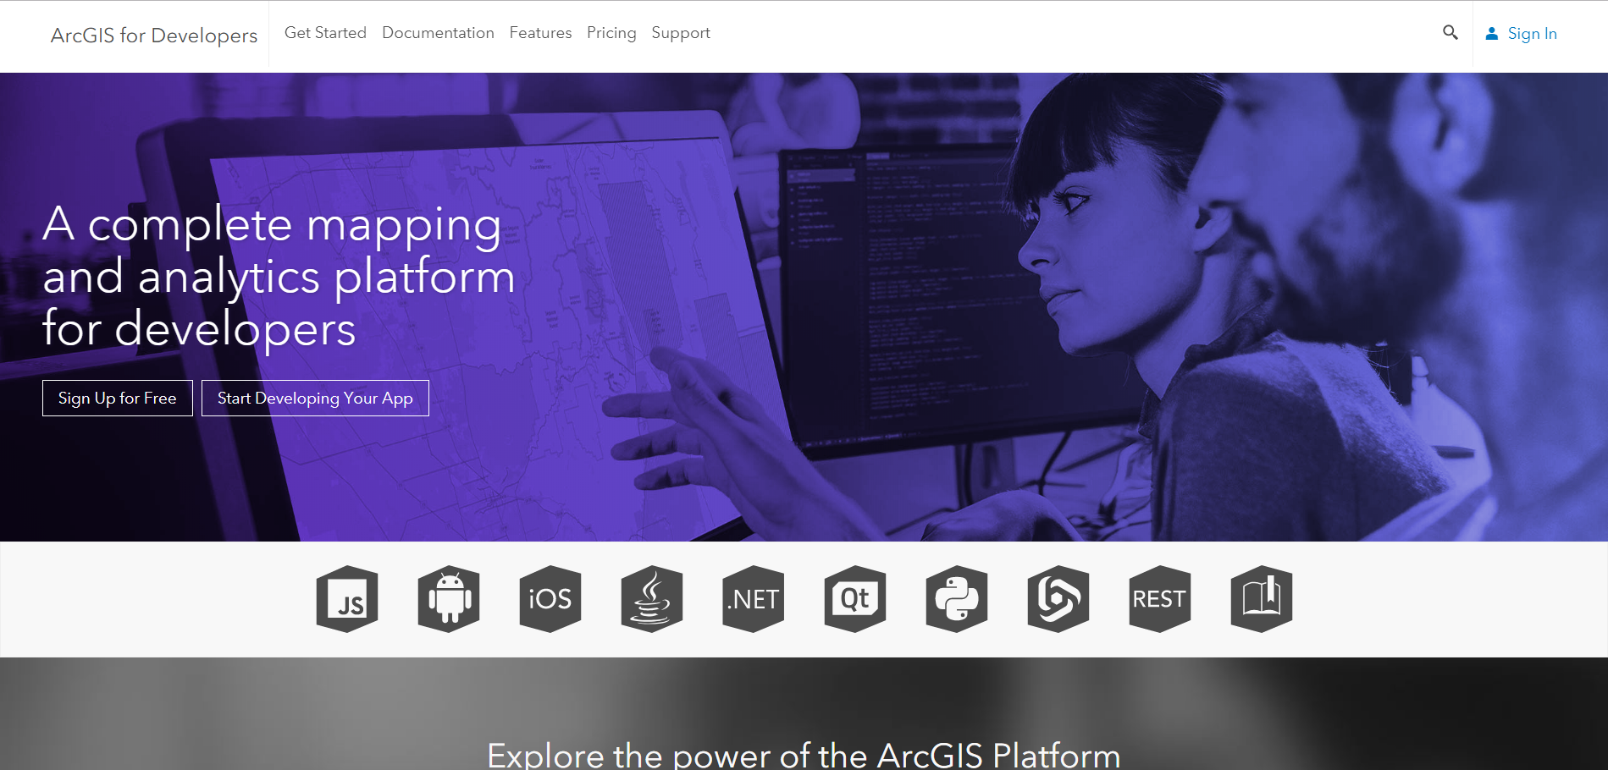
Developers Resources
Getting started with developer tools
developers.arcgis.com
Broken down by language
API References
Programming Concepts
Dev Labs
10-15min introductions
Download APIs/SDKs

Slide 17
Artificial Intelligence
Video Game Behavioral AI
Natural Language Processing
Computer Vision
Machine
Learning
Robotics
Keras
Theano
CNTK
TensorFlow
IBM
Watson
scikit-learn
Deep
Learning
Convolutional Neural Networks

Slide 18
Artificial Intelligence
Video Game Behavioral AI
Natural Language Processing
ArcGIS
Computer Vision
Machine
Learning
Robotics
Keras
Theano
CNTK
TensorFlow
IBM
Watson
scikit-learn
Deep
Learning
ArcGIS
Integration

Slide 19
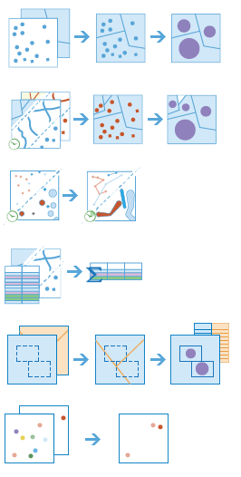
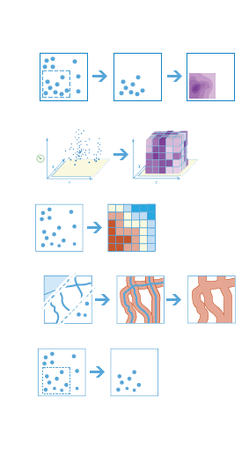
Machine Learning Tools in ArcGIS
Classification
Prediction
Maximum Likelihood Classification
Random Trees
Support Vector Machine
Empirical Bayesian Kriging
Areal Interpolation
EBK Regression Prediction
Ordinary Least Squares Regression and Exploratory Regression
Geographically Weighted Regression
Clustering
Spatially Constrained Multivariate Clustering
Multivariate Clustering
Density-based Clustering
Image Segmentation
Hot Spot Analysis
Cluster and Outlier Analysis
Space Time Pattern Mining

Slide 20






Machine Learning Integration with External Frameworks
Apps
Desktop
APIs
ArcGIS

Slide 21
Python API
Machine Learning with ArcGIS
DEMO
Machine Learning Jupyter Notebook

Slide 22


Q&A

